Slide 1
Lab #8
KestrelSAT Capstone
AKA “Choose Your Own Adventure”
Initial Guidance

Slide 2
Authorized Resources
Lab activities & lab presentation are team effort
Any non-human resource.
Generative AI Level 4 Allowed
Any human for: brainstorming / advice / limited troubleshooting.
Non-group members cannot write code for you or perform any substantive amount of work.

Slide 3
Lab #8 Proposal Turn-in
For the proposal turn-in, use the provided final presentation template and complete the first two slides: Overview and Objectives.

Slide 4
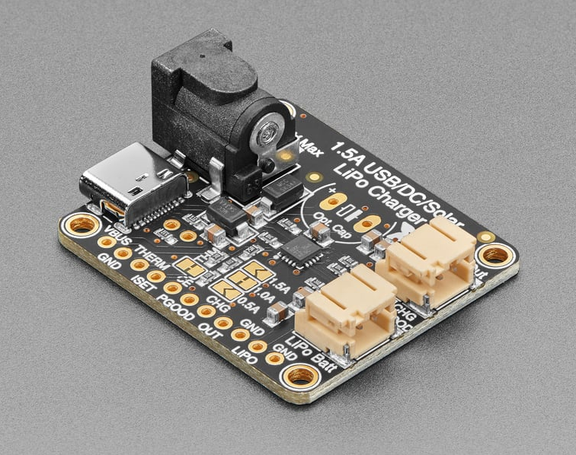
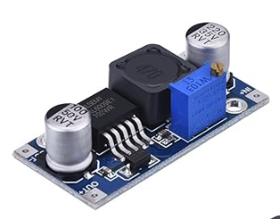
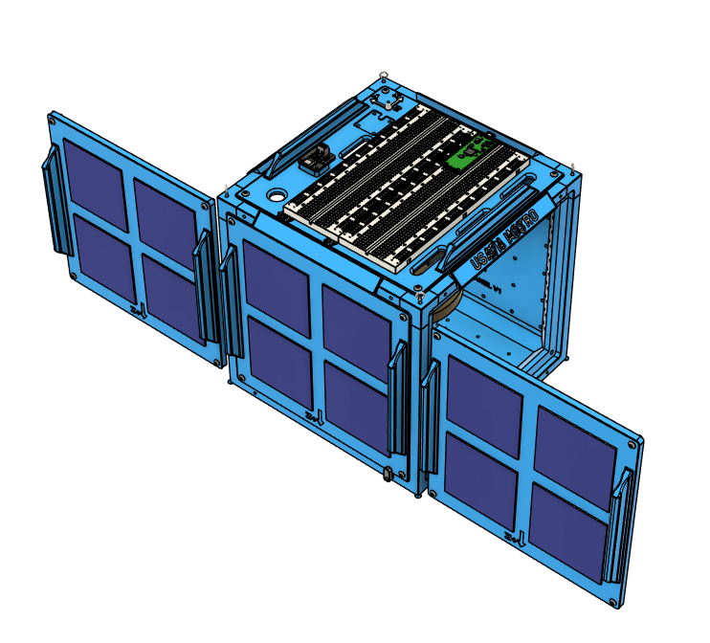
Topic Idea 1: Upgrade EPS
Goal ideas:
Add a solar power charge controller to the EPS system of KestrelSAT. Use this controller and a boost converter to charge the onboard battery.
Add solar cells as required to provide enough power to the controller to charge the onboard battery.
Record the voltage and current output from the charge controller using the onboard INA219 and determine how much charge the battery received.
Stretch Goal ideas:
(1) Design a 3D Printed Bracket mount the additional solar cells to KestrelSAT.
Adafruit Universal USB / DC / Solar Lithium Ion/Polymer charger - bq24074

Slide 5
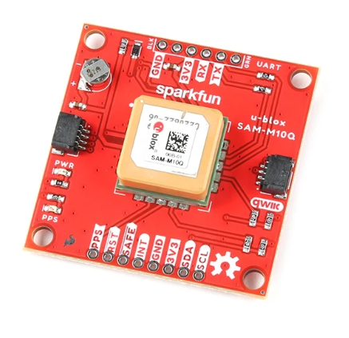
Topic Idea 2: Add GNSS Receiver
Goal ideas:
Add a GNSS receiver to KestrelSAT and record the following data:
Latitude / Longitude
Height above Ellipsoid
3D velocity
Number of Satellites in View
DOP
Record the GNSS data onboard KestrelSAT SD card, and send it over Xbee connection. Record Ground Station RSSI for each packet sent.
Conduct a simulated s/c fly-by, recording the location and RSSI over time. Plot and analyze the trajectory and RSSI.
Stretch goal ideas:
Get and examine Az/El and C/N0 for GNSS Sats in view.
SparkFun GPS Breakout - Chip Antenna, SAM-M10Q (Qwiic)

Slide 6
Topic Idea 3: Active Control of KestrelSAT Attitude
Goal ideas:
Implement a control algorithm that uses the reaction wheel to stabilize KestrelSAT’s attitude about the Z-axis to a particular attitude (e.g. slew magnetic heading or track sun).
Stretch goal ideas:
Dynamically update heading setpoint over Xbee connection.
Implement a complimentary filter sensor fusion algorithm to combine gyro heading and magnetometer heading.
Add a small PC fan to simulate a disturbance (e.g. a stuck thruster) and examine if/how the control system can overcome this disturbance.

Slide 7
Topic Idea 4: Send Image over XBee Connection
Goal ideas:
Transfer image from SD card over Xbee connection.
Stretch goal ideas:
Save an image captured by the onboard camera to SD.
Transfer an image captured by the onboard camera over the XBee connection to the ground station.

Slide 8
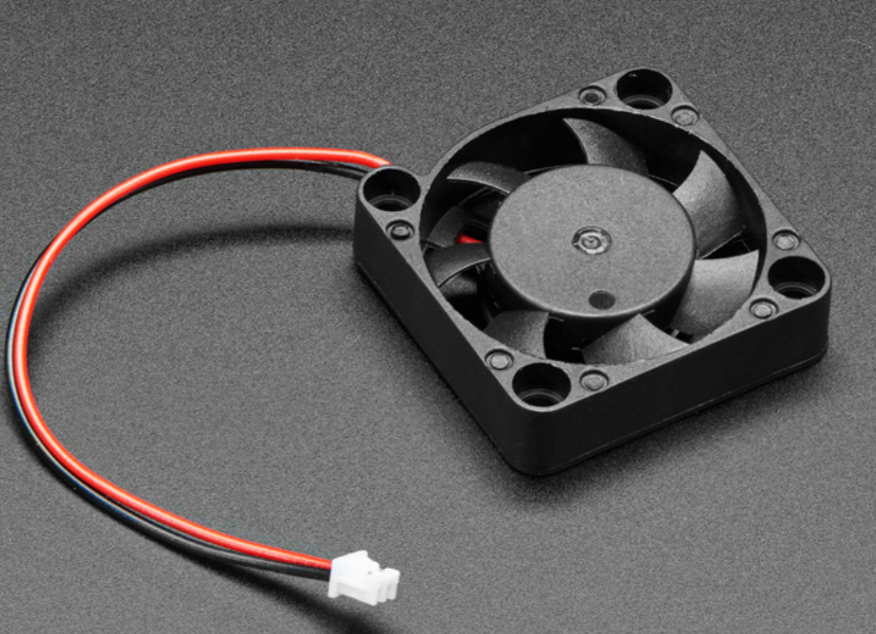
Topic Idea 5: Add Thrusters
Goal ideas:
Design and 3D print a mount for two small PC fans to attaches to KestrelSAT and act as thusters.
Examine maneuvering KestrelSAT with these thrusters. Experimentally determine the amount of thrust produced by the thrusters.
Examine momentum dumping of the RW using the thrusters.
Stretch goal ideas:
(1) Develop an active controller that uses the thrusters (and RW if desired) to control KestrelSAT attitude to a specific heading.

Slide 9
Topic Idea 6: Integrate Magnetorquer
Goal Ideas:
Understand theory of magnetorquers and design/build one (or use ones in lab)
Attach to KestrelSAT and demonstrate slew maneuver using it
Stretch Goal Ideas:
Demonstrate momentum dumping of reaction wheel using magnetorquer

Slide 10
Topic Idea 7: Create TCS Lab
Goal Ideas:
Design a KestrelSAT lab demonstrating TCS topics
Incorporate thermocouples to measure temperature of parts
Create lab procedures and documentation
Stretch Goal Ideas:
Create an actively controlled TCS (e.g. radiator with louvers)

Slide 11
Other ideas (discuss with instructor)
Design an improved sun sensor and creation a sensor fusion algorithm to combine it with gyro data
Design PCB for sun sensor
Real-time calibration of magnetometer
3DOF attitude estimation using gyro
Antenna radiation pattern characterization
Sun tracking solar array
Vibe test KestrelSAT

